Slide 1
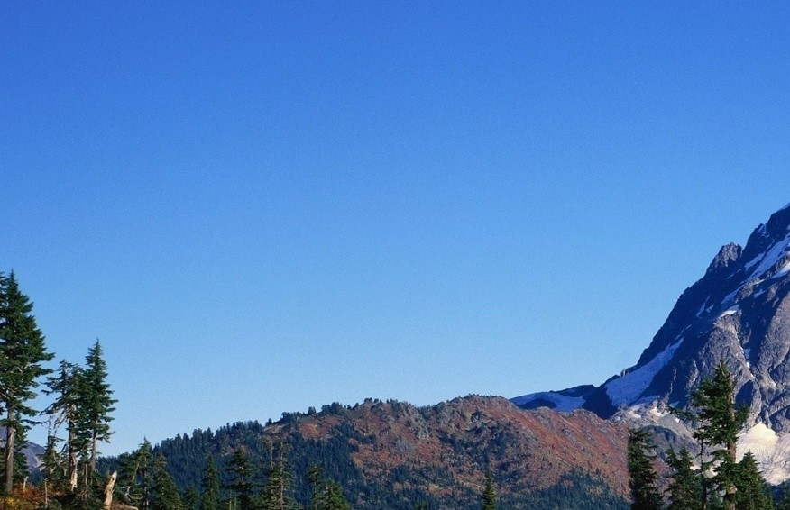
Technological Hazards
These hazards have a wide and varied interpretation.
They can vary from a single toxic gas leak to an entire industry (e.g., nuclear energy).
Ex. An earthquake that causes an oil spill form a pipeline

Slide 2
Technological Hazards
Hybrid disasters may fit into this category.
Ex: An earthquake that causes an oil spill from a pipeline
Technological disasters involving the environment are included in this category as well.
Ex: The sinking of the Titanic and explosion of the Challenger space shuttle

Slide 3
Vulnerability to Technological Hazards
Typically, the death tolls from technological hazards are relatively low.
Vulnerability is greatest for those involved in specific industries or transportation systems.
Workers in resource industries in hinterlands are at higher risk (e.g., miners)

Slide 4
Categories of Technological Hazards
Widespread
- long term (hazards that lead to cumulative effects)
Rare Events
Airplane crashes
Mine collapses
shipwrecks
Relatively common
- automobile accidents
poisons

Slide 5
Cumulative Effects
These are conditions that worsen slowly over time as exposure to a concentration increases.
Eventually, the concentration reaches a threshold critical to human health.
Hazards with cumulative effects include exposure to radiation, toxic chemicals, acid precipitation, and groundwater contamination

Slide 6
Calculating Risk
Infrastructure (bridges, dams, pipelines):
Risk is defined as the probability of failure during the lifetime of the structure.
Transportation (travel by road, sea, rail):
Risk is the probability of death or injury per km travelled
Industry (manufacturing, energy production):
Risk is the probability of death or injury per person per number of hours exposed

Slide 7
Radon
The primary source of radon gas is from the natural decay of uranium in rock and soil.
When radon is inhaled it decays to polonium and lodges in the lungs where it damages tissues.
It is the 2nd leading cause of lung cancer in Nroth America

Slide 8
Radon
Radon becomes a hazard when it is released into our living space.
It is difficult to detect because the gas is odourless, colourless, and tasteless
Radon detectors are commercially available in areas where it is of greater concern.

Slide 9
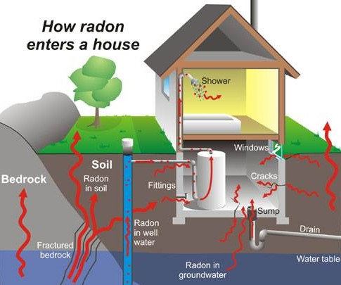
Radon
The gas can move quickly through non-saturated soil and can seep into homes.
Basements are at higher risk especially in winter due to reduced air circulation

Slide 10
Genetically Modified Organisms
These are organisms that have had changes made to their DNA by the transfer of genes.
The most common crops that are genetically modified are corn, soybeans, canola, and wheat.
Crops are modified to increase yields.
Some crops have been genetically engineered to have greater resistance to:
- extreme changes in temperature or precipitation
- herbicides

Slide 11
Genetic Modification
Examples of feats in genetic modification:
- chickens that lay low-cholesterol eggs
- tomatoes that can reduce the risk of cancer
- bananas and potatoes to treat some viral diseases that are common in developing countries
- rice that contains more Vitamin A
- bacteria that can quickly clean up oil and toxic spills
- citrus trees producing fruit in their first year when it would normally take six years

Slide 12
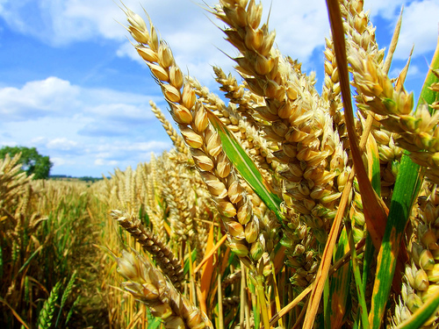
Genetic Modification
How safe are genetically modified foods?
Scientists believe that the benefits outweigh the potential risks but most support more research studies.
The UN food and Agriculture Organization believes that genetically modified crops have great benefits

Slide 13
Radiation
The impact of radiation on people can be direct (effects are evident within days of exposure) or delayed and chronic (leukemia, cancer).
The impact could be indirect in the form of genetic effects
Ex: A person may not experience effects but may pass them on to their children in the form of chromosomal changes or birth defects.

Slide 14
Potential Sources of Radiation
Mining of Uranium
In Canada, uranium is mined in Northern Saskatchewan and Northern Ontario.
Mines produce wastes known as tailing that can be a radioactive hazard
Production of Electricity
Uranium is used in nuclear powerplants

Slide 15
Nuclear Power Plants
Most nuclear plants in North America are in the eastern half of the continent.
They must be near sources of coolant (rivers or lakes).
They must be located near a market for electricity (eastern North America is much more populated).
Nuclear is considered a clean source of energy because it does not emit the greenhouse gases that cause climate change

Slide 16
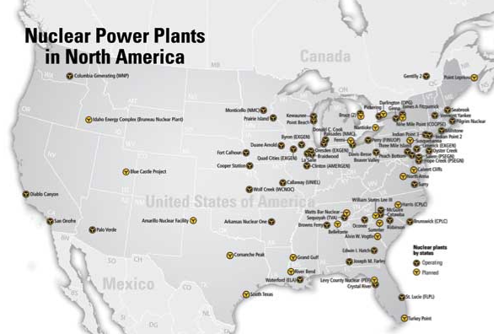
Locations of Nuclear Power Plants

Slide 17
Nuclear Accidents
A nuclear meltdown is an informal term for an accident that results in damage from overheating.
It occurs when the heat generated by a nuclear plant exceeds the heat removed by its cooling systems.
In a meltdown, fuel rods turn to liquid and the walls of the plant could melt from the extreme heat.
The hot liquid could melt through the bottom of the plant and seep into the soil

Slide 18
Three Mile Island Nuclear Accident
This is the worst nuclear disaster in U.S. history; it occurred on March 28, 1979
One of the two power plants on Three Mile Island in Central Pennsylvania experienced a partial meltdown.
It was caused by a failure of a valve that controlled cool water entering the plant.
There were no direct injuries; minor amounts of radiation were released, and the plant closed

Slide 19
Chernobyl Nuclear Accident
This is the worst nuclear disaster in world history; it occurred on April 26, 1986.
The accident was a result of flawed design, operator error, and disregard of safety regulations
An explosion at the plant caused the immediate deaths of three workers. Within one year, 28 more workers died from extreme radiation exposure.
Over the following two decades, thousands of people developed thyroid cancer attributed to radiation exposure

Slide 20
Nuclear Energy
The combined concern over Three Mile Island and Chernobyl slowed nuclear development for a time.
However, concern over greenhouse gas emissions has created a high demand for cleaner sources of energy.
The last remaining coal power plant in Ontario closed in 2014
The province has invested in refurbishing existing nuclear power plants and is planning to build new ones as well.

Slide 21
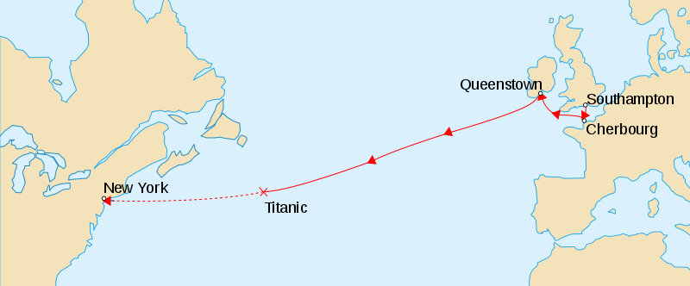
Titanic Shipwreck
The Titanic was a passenger ocean liner that struck an iceberg and sank on its maiden voyage (April 15, 1912).
The ship left Southampton, England on April 10th and was bound for New York City with 2224 passengers

Slide 22
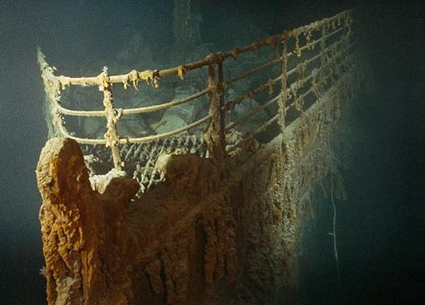
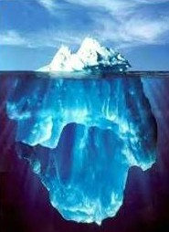
Titanic
The ship was designed using advanced technology and was believed to be unsinkable.
The death toll was 1517; the high number was due to the lack of lifeboats for all passengers
The wreckage was found by SONAR in 1985 iat a depth of 3.8km

Slide 23
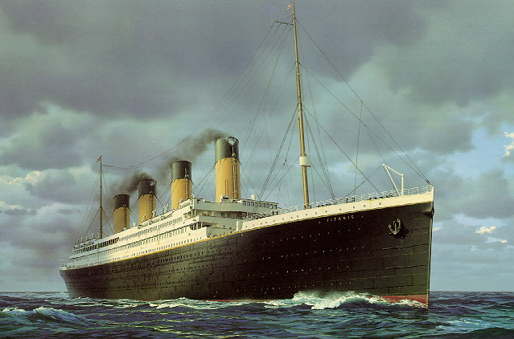
Chronology of the Titanic Shipwreck
A lookout on the ship spotted an iceberg in the ship’s path at 11:40 PM and alerted the captain.
The ship struck the iceberg 37 seconds later; 18 lifeboats were launched, and Titanic sank at 2:20 AM.
The Carpathia arrived at 4:10AM and picked up survivors from the lifeboats

Slide 24
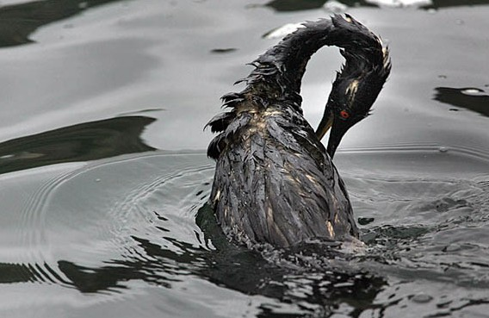
Oil Spills
Oil spills most commonly occur in water but can also occur on land due to pipeline bursts.
The environmental impact can be devastating, and clean-up can take months to years.
Oil penetrates bird feathers and mammal fur reducing the ability to insulate
Birds and animals are left vulnerable to temperature changes and become less buoyant in water

Slide 25
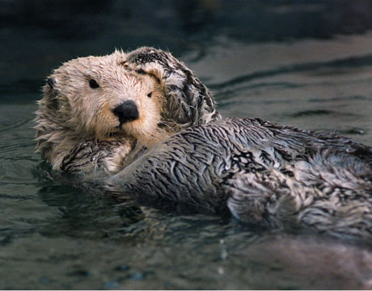
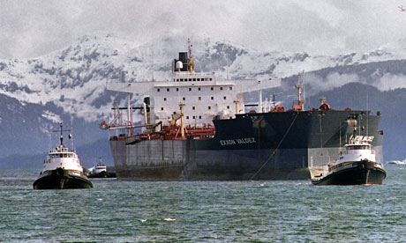
Exxon Valdez Oil Spill
It was caused by an oil tanker ship striking a rocky reef off the south coast of Alaska on March 24, 1989.
The region is an important habitat for salmon, seals, sea otters, killer whales , and seabirds

Slide 26
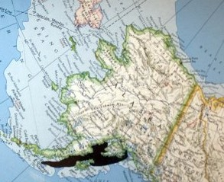
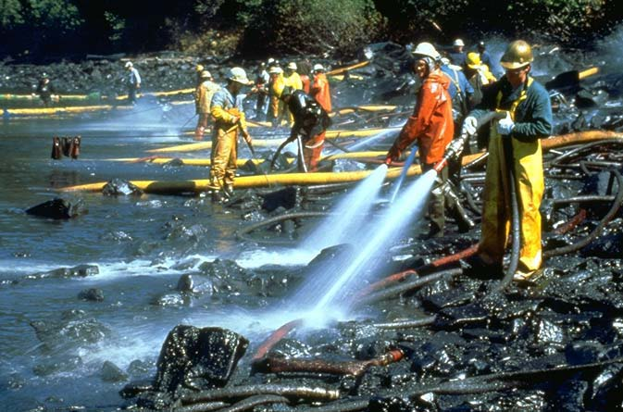
Exxon Valdez Oil Spill
There were 75 million litres of oil spilled; the remote location made recovery efforts difficult.
It remained the worst oil spill in North American history until the Deepwater horizon oil spill

Slide 27
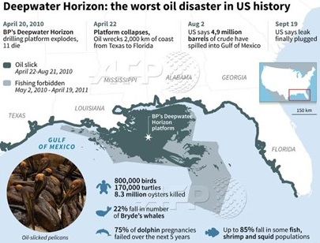
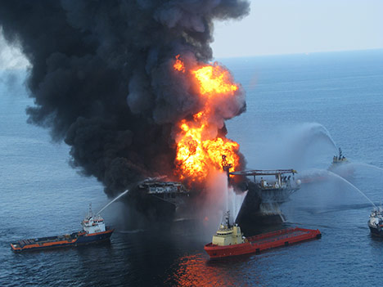
Deepwater Horizon Oil Spill
The spill was caused by an oil rig that exploded in the Gulf of Mexico on April 20, 2010.
The explosion killed 11 workers. It was caused by methane rising upward through a drill pipe

Slide 28
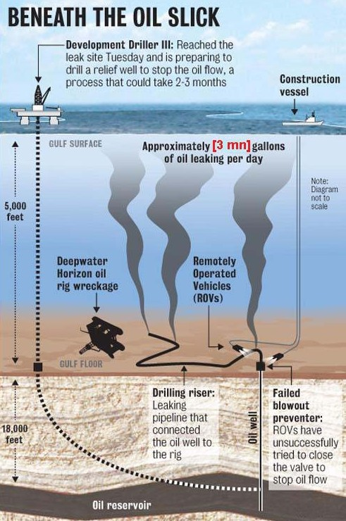
Deepwater Horizon Oil Spill
Approximately 11 million litres of oil leaked from the well every day for months.
After several failed attempts, the well was finally capped with cement on September 19, 2010

Slide 29
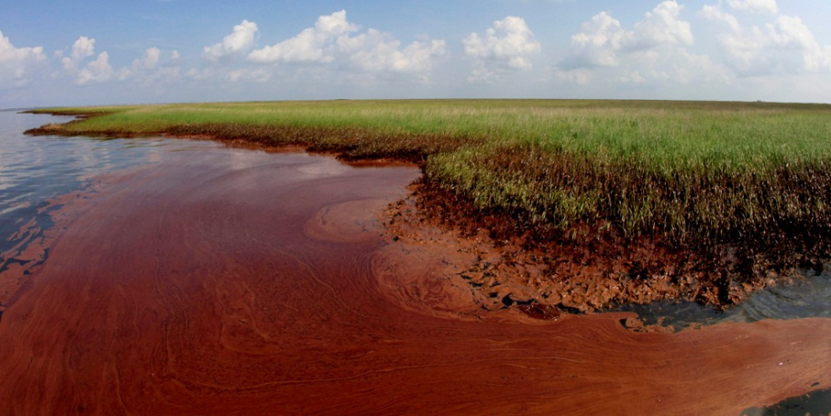
Deepwater Horizon Oil Spill
The spill caused extensive damage to wetlands and beaches along the U.S. Gulf of Mexico coastline.
The tourism industry faced
severe economic loss during
summer 2010.
The U.S. federal investigative report ultimately blamed the B.P. oil company for the disaster. The report found that the company:
Make a series of cost-cutting choices on maintenance
Did not have a proper system in place to ensure safety

Slide 30
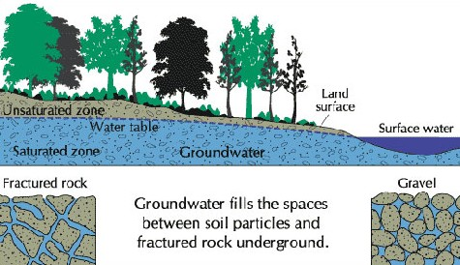
Groundwater
Groundwater is water that is found within the cracks, spaces, and pores in soil, sand, and rock.
These material are permeable because they have connected spaces that allow water to flow through

Slide 31
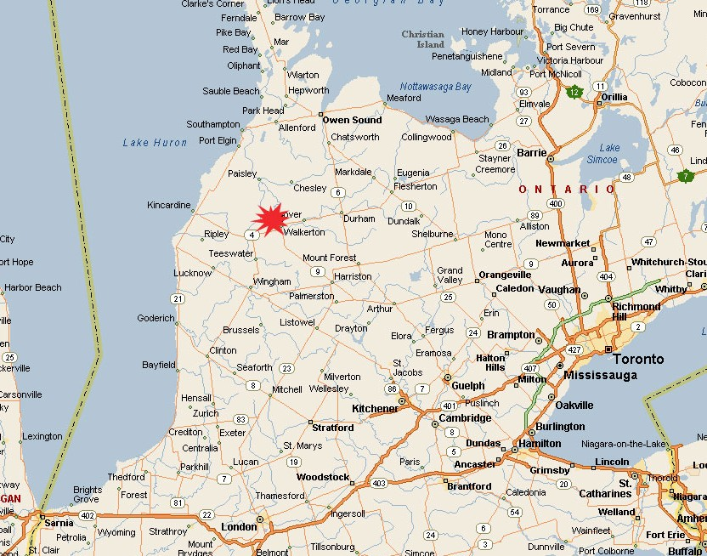
Groundwater Contamination
Many cities and towns obtain drinking water from groundwater. If the water supply becomes contaminated, this presents a risk.
In 2000, water contaminated with E. coli bacteria killed 7 people in Walkerton, Ontario.
The bacteria came from fertilizer manure that had leached into a well during a heavy rainfall

Slide 32
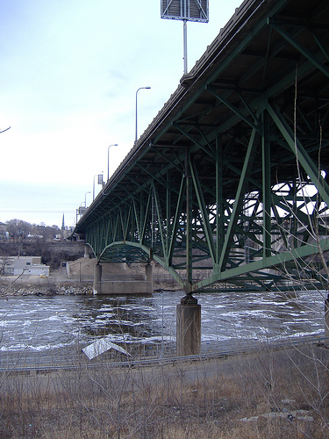
Infrastructure Failure
An example of infrastructure failure in North America occurred in Minneapolis in 2007.
A highway bridge over the Mississippi River collapsed during evening rush hour killing 13 people.

Slide 33
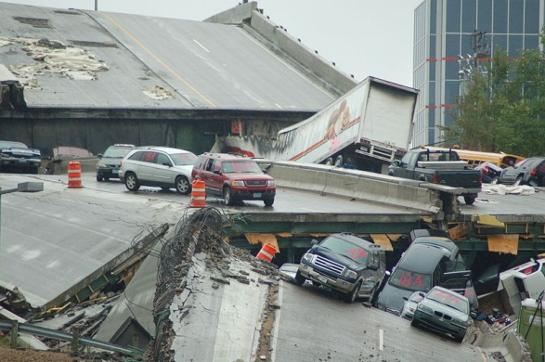
Minneapolis Bridge Collapse
The cause was deemed to be excessive weight from vehicles and construction equipment
The bridge supports were not of proper thickness and an extra 2 inches of concrete that was added to the roadway also contributed to the collapse.

Slide 34
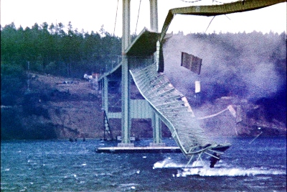
Tacoma Narrows Bridge Collapse
In 1940, high winds caused the collapse of a suspension bridge in Tacoma, Washington.
There were no human casualties from the collapse

Slide 35
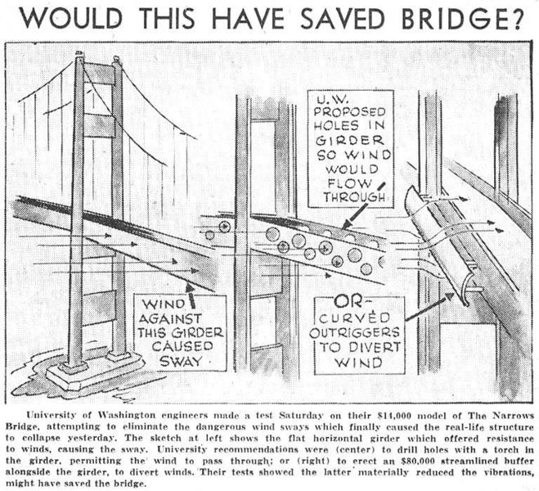
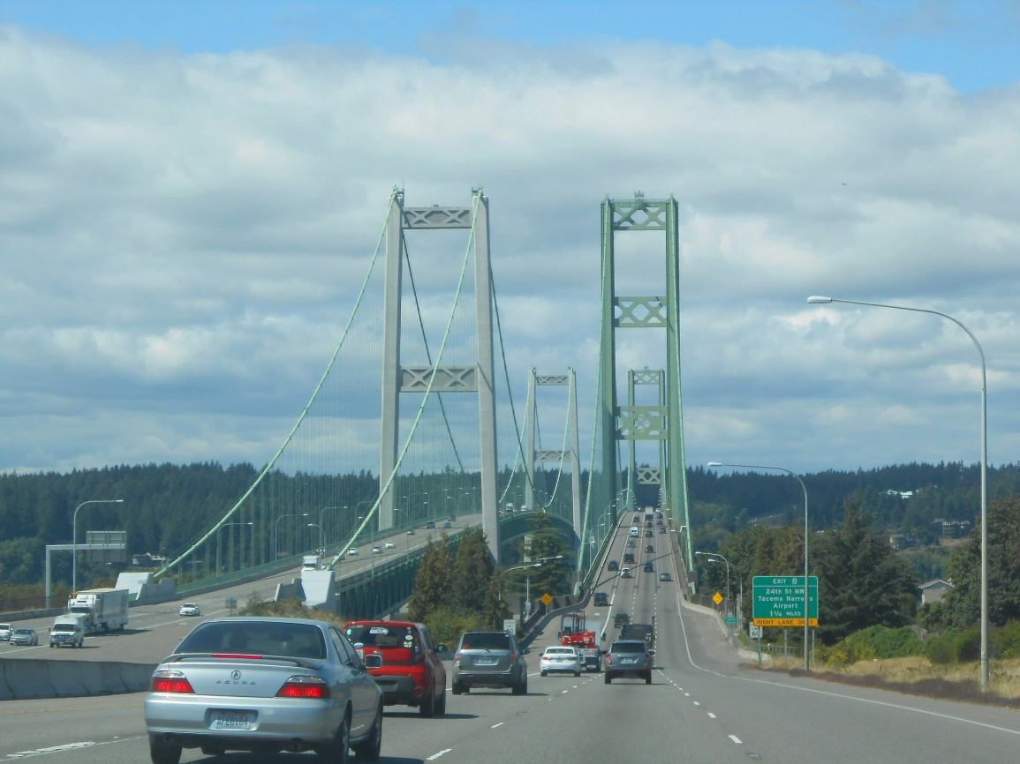
Tacoma Narrows Bridge
The design of the bridge did not provide any open trusses for wind to pass through.
The incident serves as a good case study for engineering and architecture students

Slide 36
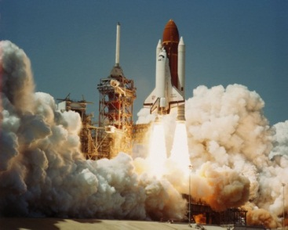
Space Shuttle Explosions
There have been two major space shuttle disasters: Challenger and Columbia.
The Challenger exploded 73 seconds into its flight on Jan 28, 1986
All seven crew members were killed as the space shuttle disintegrated; its remains were scattered over the Atlantic Ocean.

Slide 37
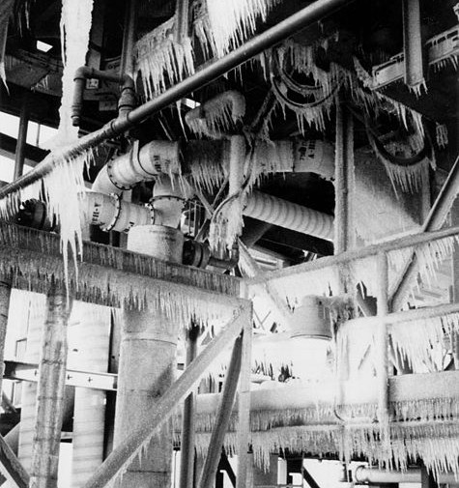
The Challenger Shuttle Explosion
The cause was associated with a rubber O-ring seal.
It failed to seal a joint leading to the release of hot gas that led to failure of the rocket booster
The night before the launch was particularly cold; frost and ice had developed on the rocket.

Slide 38
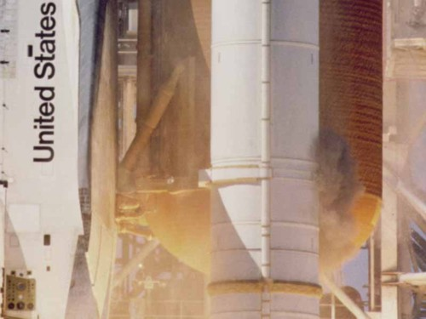
The Challenger Shuttle Explosion
It is believed the cold weather reduced the elasticity of the O-ring preventing it from properly sealing the joint.

Slide 39
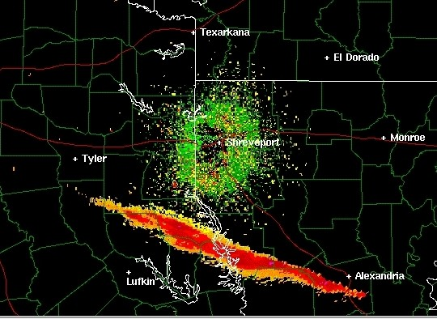
The Columbia Shuttle Explosion
The Columbia disintegrated on Feb. 1, 2003, upon re-entry into Earth’s atmosphere after 16 days in space.
During launch, a piece of insulation broke off from the external tank
It struck the left wing and damaged the system that protects the wing from the intense heat produced by atmospheric gases upon re-entry.
Pieces of the shuttle were found in Texas and Louisiana

Slide 40
Formation of the Solar System
How was the solar system formed?
Scientists believe a cloud of gas and dust in space was disturbed by a supernova.
When did this occur?
4.6 billion years ago
The Nebular Hypothesis
The supernova explosion made waves in space
This caused the formation of a solar nebula (a flattened cloud of gas and dust)
Supernova: the explosion of a star that has reached the end of its life cycle

Slide 41
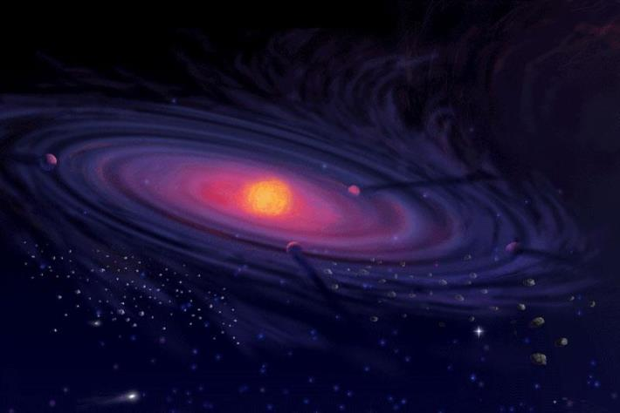
Formation of the Planets
The centre of the solar nebula grew hotter resulting in the formation of the Sun.
The outer edges cooled causing clumps of particles to stick together and form planets

Slide 42
Components of Outer Space
Galaxy
A cluster of billions of stars. Our solar system makes up a tiny portion of the Milky Way Galaxy
Star
A hot glowing ball of gas that generates energy by converting hydrogen to helium

Slide 43
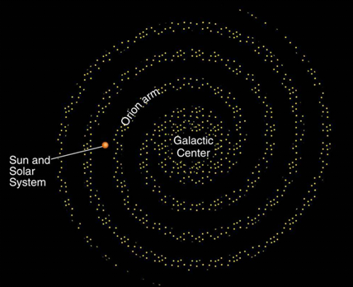
The Milky Way Galaxy
The Sun is located approximately 30 quintillion km from the centre of the Milky Way galaxy.
It takes light nearly 100,000 years to travel from one side of the galaxy to the other

Slide 44
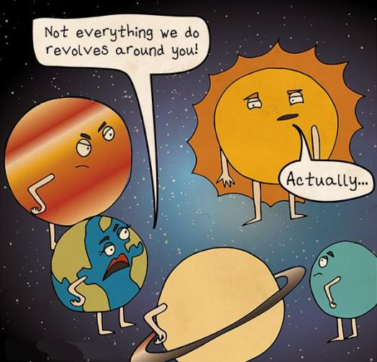
The Sun
In the core of the Sun, the temperature is 15,000,000°C.
The outermost part of the Sun is called the photosphere, and it is 6000°C.
Energy from the Sun controls the Earth’s climate system
The sun is so large relative to Earth that Earth only receives two-billionths of the Sun’s total energy

Slide 45
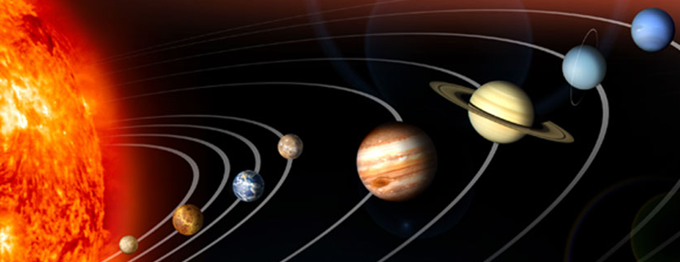
The Solar System
The solar system is composed of 8 planets, 214 moons, and millions of bolides.
Order of the planets: Mercury, Venus, Earth, Mars, Jupiter, Saturn, Uranus, Neptune

Slide 46
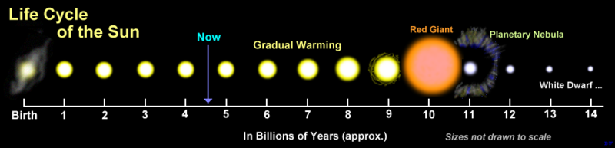
Life Cycle of Stars
The Sun is the closest star to Earth; it has a life expectancy of approximately 10 billion years.
At the end of its cycle of a star, massive amounts of energy are released in an explosion (supernova)

Slide 47
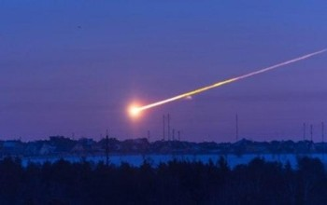
Bolide
Definition:
An extraterrestrial body that originates in outer space
Examples
Asteroid: A rocky metallic material in space 10 m to 1000 km in diameter originating in the Asteroid Belt (between Mars and Jupiter).
Meteoroid: Similar composition to an asteroid but only up to 10m in diameter

Slide 48
Bolides
Meteor: A meteoroid that has entered Earth’s atmosphere.
Meteorite: A meteor that strikes the Earth’s surface
Comet: These are distinguishable by a large glowing tail of gas and dust
It is believed that comets originated from an area outside the solar system called the Kuiper Belt.

Slide 49
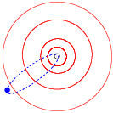
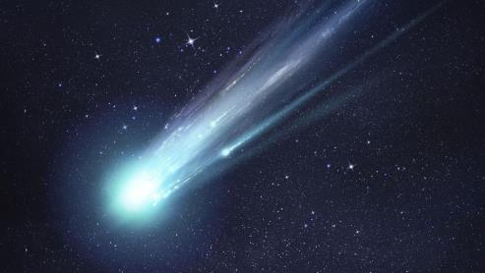
Comets
Comets create light as gases are released while the comet is heated by solar radiation.
Halley’s Comet is the most famous because it is visible with the naked eye and passes close to Earth every 75 years.
It will next be visible in 2061

Slide 50
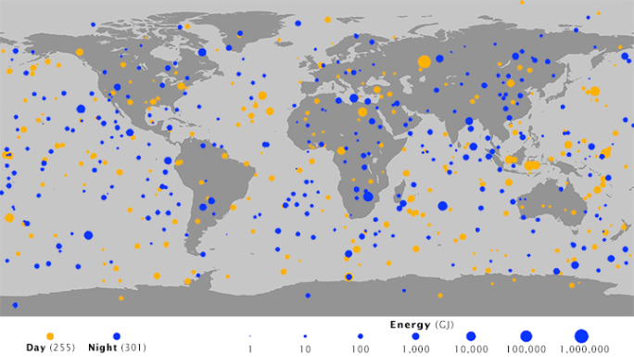
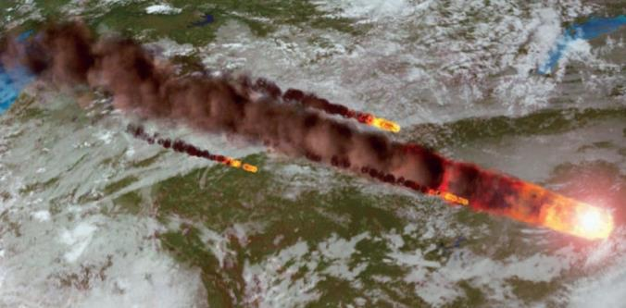
Airbursts
Bolides travel at velocities of 12-72 km/s.
As they heat up upon entering Earth’s atmosphere, they produce bright light.
Many bolides explode at an altitude between 12 km and 50 km; the explosion is referred to as an airburst.

Slide 51
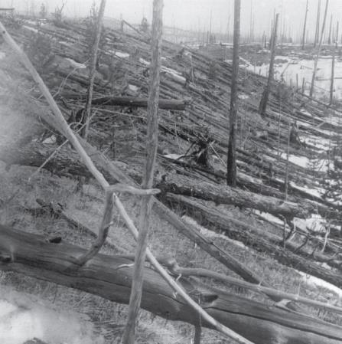
Tunguska Airburst
The explosion destroyed over 2000 km² of forest in a sparsely populated area of northeast Russia in 1908.
Scientists have determined it was an airburst because no crater has ever been found
The asteroid responsible is believed
to be 25 to 50 metres in diameter.

Slide 52
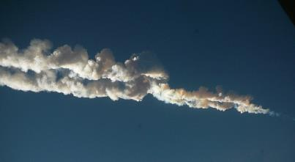
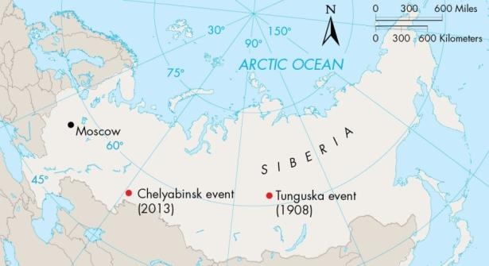
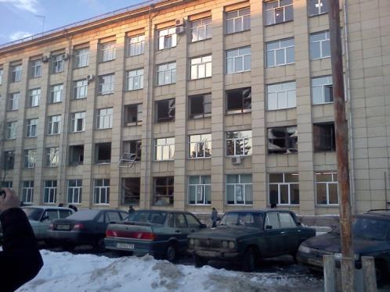
Chelyabinsk Airburst
On Feb. 15, 2013, a meteor exploded over the city of Chelyabinsk, Russia creating a shockwave.
It was the largest bolide to enter Earth’s atmosphere since the Tunguska airburst
Over 1500 people were injured, mainly from broken glass.

Slide 53
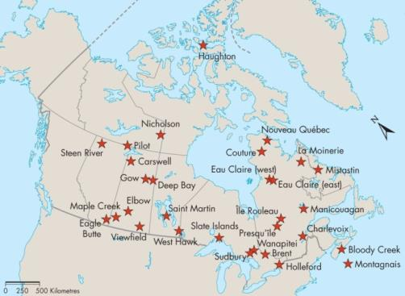
Impact Craters
These provide evidence of past meteorite impacts.
A layer of debris around a crater called an ejecta blanket consists of rock fragments that were blown out of the crater upon impact.
A crater seen today is not as deep as the original crater due to erosion and gragmented rock falling back into it shortly after impact
This rock is referred to as breccia.

Slide 54
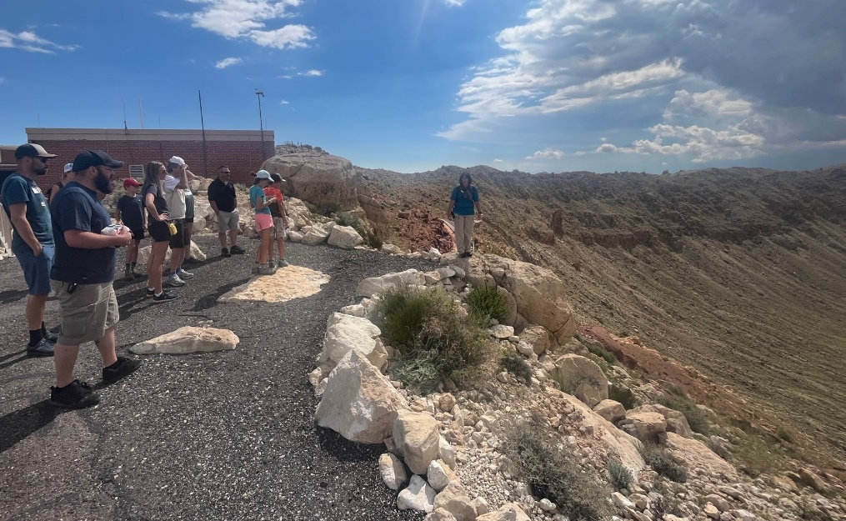
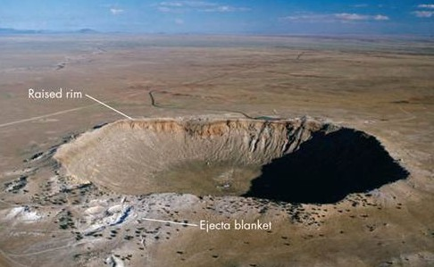
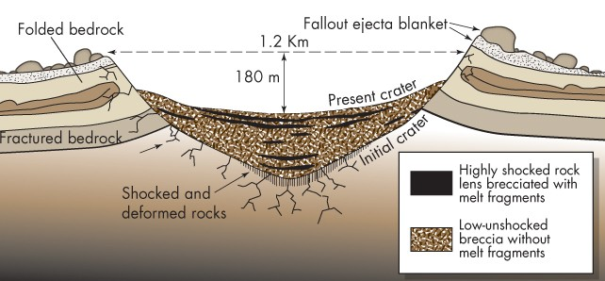
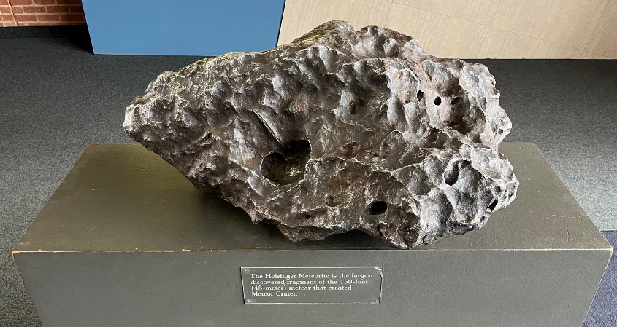
Meteor Crater
This crater is in Arizona and was formed about 50,000 years ago.

Slide 55
Impact Craters
Impact craters can be defined as either simple or complex.
Simple craters are less than a few km in diameter and do not have an uplifted centre.
A complex carter consists of a rim that collapses and a center floor that slowly rises following impact
Complex craters are generally greater than 5km in diameter

Slide 56
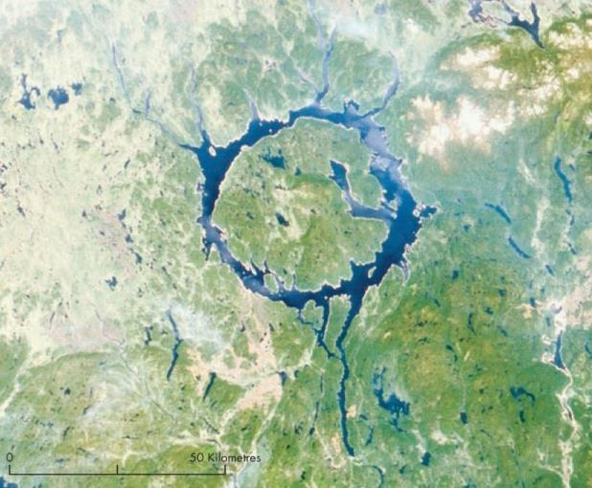
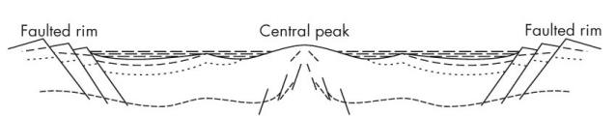
Manicouagan Crater
This complex impact crater is 100 km in diameter and is one of the largest in the world.
It is in Central Quebec and was formed 214 Million years ago.
The rim collapsed and the rock has eroded to form a ring-shaped lake.

Slide 57
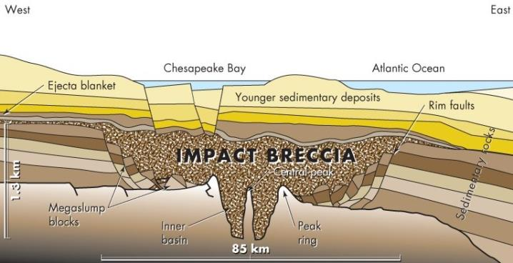

Chesapeake Crater
This crater was not discovered until subsurface imaging and drilling revealed its presence off the coast of Virginia.
The crater formed 35.5 million years ago.
Since then, it has been overlain by sediment and seawater as sea levels have risen

Slide 58
Impact Craters
Why are craters much more common on the Moon than on Earth?
- most impacts with Earth are on oceans thus no crater can be produced
- impacts with Earth’s land have been eroded or buried and therefore have more subtle features than Moon craters
- smaller bolides often burn up and disintegrate in Earth’s atmosphere before striking its surface

Slide 59

Shoemaker-Levy Comet
This comet entered Jupiter’s atmosphere in 1994.
Massive amounts of energy were released, and gas plumes were produced as 21 fragments of the comet collided with Jupiter.
After this impact, it was universally accepted that a similar impact could one day strike Earth

Slide 60
Mass Extinctions
Extinctions coincide with boundaries of geologic periods on the geologic time scale.
These are usually consistent with abrupt changes in climate from volcanism, bolides, or human impacts.
There have been 5 Major extinctions during the past 55- million years and a 6th is occurring today

Slide 61
K-T Boundary Mass Extinction
It occurred 65 million years ago from the abrupt cooling caused by a bolide impact.
It is named for the boundary separating the Cretaceous and Tertiary Periods. In some languages, Cretaceous is spelled with a “K”.
This event caused the extinction of the dinosaurs which had been at the top of the food chain for 100 million years
It also caused the extinction of 70% of all plant and animal species that existed at the time.

Slide 62

Earth History

Slide 63
K-T Boundary Mass Extinction
How was the extinction determined to be from a bolide impact?
Scientists found large quantities of iridium in rock that was dated at 65 millions old.
The hypothesis of an impact was at first criticized because no crater had been found.

Slide 64

K-T Boundary Crater
The K-T crater was discovered in 1991; it is 180 km in diameter and was found underlying sediment and seawater.
Analysis of the crater suggests the impact produced 10,000 times the energy of the entire nuclear arsenal of the world today.

Slide 65


Linkages with other Hazards
Bolide impacts can trigger tsunamis, earthquakes, landslides, and cause climate change.

Slide 66
Risk from Bolide Impacts
If a bolide remains in the Asteroid Belt (between Mars and Jupiter), it poses no hazard to Earth.
Scientists estimate that an urban area would be destroyed once every 30,000 years by a bolide similar in size to the Tunguska airburst (which has a 1000-year recurrence interval).

Slide 67

Bolide Impact Frequency

Slide 68
Managing the Bolide Impact Hazard
The Spaceguard survey program has catalogued all near-Earth orbits larger than 1 km in diameter.
Extending the inventory to bolides as small as 100 metres in diameter is a current objective.

Slide 69


Managing the Bolide Impact Hazard
Blowing up an approaching bolide will cause fragments to rain down and is not advisable.
Pushing a bolide off course by ramming it with a spacecraft is the recommended approach.

